Slide 1

Digital Government
Winter 2019

Slide 2






Why “Digital”?
The Digital Vision
The Digital Plan
The Digital Challenges
The Digital Standards

Slide 3




Why “Digital”?

Slide 4
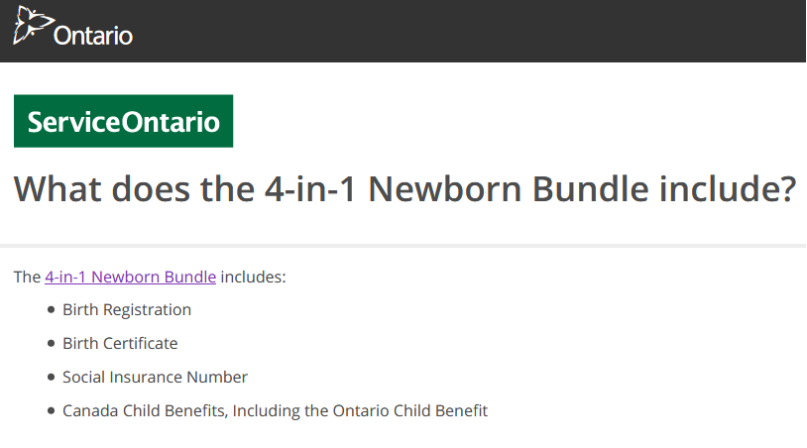

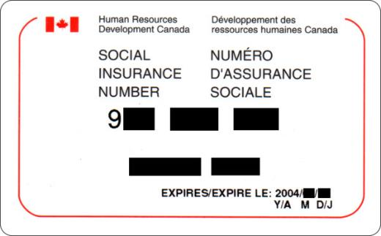

Why “Digital”?

Slide 5











Why “Digital”?
change
agricultural revolution
1st
2nd
3rd
4th
industrial revolution
industrial revolution
industrial revolution
industrial revolution

Slide 6

The Digital Vision
The Government of Canada is an open and service-oriented organization that operates and delivers programs and services to people and businesses in simple, modern and effective ways that are optimized for digital and available anytime, anywhere and from any device.
Digitally, the Government of Canada must operate as one to benefit all Canadians.

Slide 7

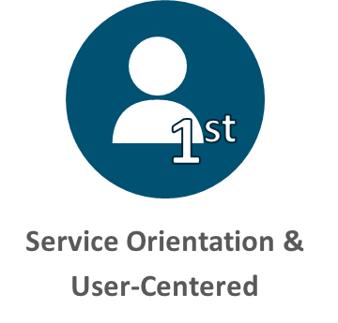
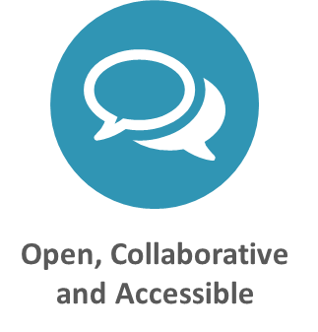


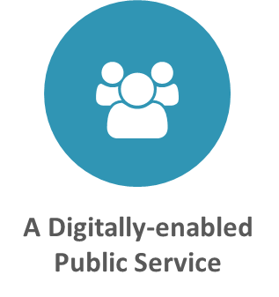

The Digital Plan
Digital Operations Strategic Plan
Canadian Digital Service
“Tell Us Once” Approach
Digital Standards
Information Sharing Horizontal Review
The Vision
The Enablers

Slide 8
The Digital Plan
Digital Operations Strategic Plan
ATI Portal
Open Data Portal
Open Government Partnership
Open by Default Pilots
Data Strategy
The Vision
The Enablers

Slide 9
The Digital Plan
Digital Operations Strategic Plan
Any Time, Any Channel
OneGC
Digital Identity
Artificial Intelligence
The Vision
The Enablers

Slide 10
The Digital Plan
Digital Operations Strategic Plan
Interoperability & Data Standards
Digital Policy
Digital Academy
Talent Cloud
Lead Innovation
Digital 9 (D9) Participation
The Vision
The Enablers

Slide 11

The Digital Challenge
Governing the Change
Incentivizing the Change
Skilling the Change
Maintaining the Change
Resourcing the Change
Timing the Change

Slide 12











The Digital Standards

Slide 13


Slide 14

The Digital Standards
Research with users to understand their needs & the problems we want to solve
Conduct ongoing testing with users to guide design & development
Use agile, iterative & user-centred methods
Continuously improve in response to user needs
Try new things, start small, and scale up
Share evidence, research, decision-making openly
Make all non-sensitive data, info, and code open to the outside for sharing & reuse
Leverage open standards & leading practices, incl. open source software
Design seamless services & platforms for public use no matter the device or channel
Adopt a balanced approach to managing risk by deploying appropriate measures
Make security measures frictionless so that they do not burden users

Slide 15
The Digital Standards
Create multidisciplinary teams with the skill range needed to deliver a common goal
Share, collaborate in the open
Create partnerships that deliver user value
Make sure everyone receives fair treatment
Comply with ethical guidelines in the design, use of systems that automate decision-making (e.g., artificial intelligence)
Collect data from users only once & reuse whenever possible
Ensure data is collected, held in a secure way that maintains quality so it can be reused by others
Make sure staff have the tools, training & technology they need
Empower the team to make decisions throughout service design, build, operation
Services should meet or exceed accessibility standards
Users with distinct needs should be engaged from the outset to ensure what is delivered will work for everyone

